Slide 1
Telecom CHURN PREDICTION
Waqas Khan

Slide 2
AGENDA
01
02
03
04
Introduction
EDA
Background and Problem Statement
Exploratory Data Analysis
Model Training
Model Explaining
Training multiple ML models
Feature Importance and Shap Analysis

Slide 3
01
Introduction
Background and Problem Statement

Slide 4
Churn Rates in Telecom
Key Performance Metric
Voluntary / Involuntary
Churn Prediction
Measured as the percentage of customers who discontinue their services
Focus is on voluntary churn, which occurs due to company-customer relationships
Use of Predictive analytics to predict churn and create focused customer retention programs

Slide 5
Problem Statement
Objective: Help Orange Telecom develop focused retention programs by creating churn prediction models
Precision
Recall
Model Metric
Of all the users that the algorithm predicts will churn, how many of them do actually churn?
What percentage of users that end up churning does the algorithm successfully find?
F1-Score
In this problem, both precision and recall are important. So we will use F1-Score for model evaluation
Notes:
Example of Precision: Consider a re-engagement email campaign which says something like “We noticed you may be leaving us. Please don’t!” You’d likely want to ensure that the precision for this email was high. In other words, you would want to minimize the number of happy users who see this email, and instead have this email almost exclusively hit users in danger of churning.
Example of Recall: On the other hand, consider an email that you want to send more broadly to your user base – maybe an offer to receive $5 of the next purchase. You’d be less concerned with users who are not in danger of churning receiving this marketing message. Ideally, though, you would want anyone who might churn to see the email. In this case, you would want your recall to be higher than your precision.

Slide 6
02
EDA
Exploratory Data Analysis

Slide 7
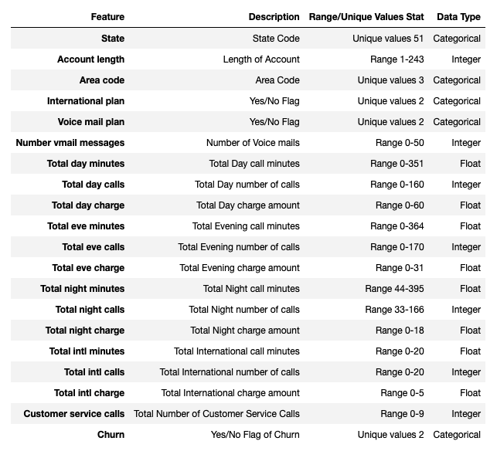
Data Summary
Data Set
Imbalanced Classes

Slide 8
Distribution Comparison
Customer who Churned:
Made 2x more service calls
Had 20% more Bill
25% Less international calls

Slide 9
Correlation Matrix
Redundant Feature
Call minutes and Call Charge are strongly correlated with a correlation factor of 1

Slide 10
Pair Plots
Visual bivariate analysis suggests that Customer service calls and Total day minutes split the data much better as compared to other features
This confirms what we saw before when we did median value analysis between two groups

Slide 11
Statistical Analysis – T-Test
Used to test the difference between two groups on some continuous variable.
P-value is the probability that the results from sample data occurred by chance
Low p-values are good, they indicate the data did not occur by chance. In most cases p-value of 0.05 is accepted to mean data is valid
Total day minutes, Customer service calls, Number vmail messages, Total intl minutes, Total eve minutes, Total intl calls are all statistically significant with p-values < 0.05

Slide 12
Statistical Analysis – Chi2-Test
Determine if a difference between observed data and expected data is due to chance, or if it is due to a relationship between the variables you are studying
International plan, Voice mail plan and State are all statistically significant with p-values < 0.05

Slide 13
03
Model Training
Training multiple ML models

Slide 14
Models Trained
 | Feature Engineering | F1-Score
Baseline |  | 0.12
Logistics Regression |  | 0.54
Decision Tree |  | 0.92
Random Forest |  | 0.93
SVM |  | 0.59
XgBoost |  | 0.92
AdaBoost |  | 0.93
MLP Classifier |  | 0.62
Keras Classifier |  | 0.46
Modeling Steps
feature Eng
Preprocessing
Ros/SMOTE
Classifier
GridSearch
ENSEMBLE

Slide 15
Model Comparison
Tree based models outperform all other models

Slide 16
Model ENSEMBLES
Voting Classifier
Stacking Classifier
Voting Ensemble (F1-score 0.93)
Decision Tree
Random Forest
XGBoost
AdaBoost
Stacking Ensemble (F1-score 0.93)
Decision Tree
Random Forest
XGBoost
AdaBoost

Slide 17
PCA
Jump in score at 8 PCAs
The explained variance plot shows that almost all the variance in the dataset(containing 33 numerical features) could be explained by 15 PCs

Slide 18
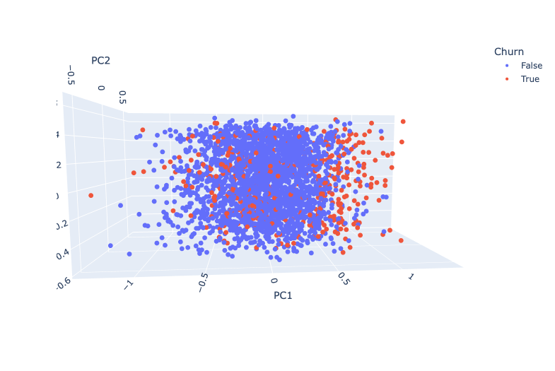
PCA
Some level of difference between the two groups for 2 & 3 PCAs but it is not a good split
More Principal Components needed to completely separate the two groups.

Slide 19
04
Model Explaining
Feature Importance and Shap Analysis

Slide 20
Feature Importance
Decision Tree Feature Importance
Shap Feature Importance
Notes:
What is Shap?
The goal of SHAP is to explain the prediction of an instance x by computing the contribution of each feature to the prediction. The SHAP explanation method computes Shapley values from coalitional game theory. The feature values of a data instance act as players in a coalition. Shapley values tell us how to fairly distribute the “payout” (= the prediction) among the features. A player can be an individual feature value, e.g. for tabular data. A player can also be a group of feature values. For example to explain an image, pixels can be grouped to superpixels and the prediction distributed among them. One innovation that SHAP brings to the table is that the Shapley value explanation is represented as an additive feature attribution method, a linear model.

Slide 21
SHAP – Summary Plot
The higher the Total_charge (red points) the more likely a customer will churn and vice versa.
However, there are some customers who tend to churn less even though they have medium to high Total_charge! (red points towards extreme left across Total_charge feature). We will explore this group more in Shap dependence plot
More Customer service calls (red) generally an indication of customer churning
Customer with an No International plan (red) tend to churn less
Notes:
The summary plot combines feature importance with feature effects. Each point on the summary plot is a Shapley value for a feature and an instance. The position on the y-axis is determined by the feature and on the x-axis by the Shapley value. The color represents the value of the feature from low to high. Points are shown as violin plot, so we get a sense of the distribution of the Shapley values per feature. The features are ordered according to their importance.

Slide 22
SHAP – Dependence Plot
Customer service calls has strongest interaction with Total_charge
International plan_Yes has strongest interaction with Total intl minutes
Notes:
SHAP feature dependence plots a point with the feature value on the x-axis and the corresponding Shapley value on the y-axis. Then color the SHAP feature dependence plot with another interaction feature (by default it gets colored by the strongest interaction feature)
Customer service calls have strongest interaction with Total_charge
Generally higher Total_charge leads to higher Shap values i.e. increased likelihood of Churn
Looking together with interaction features we observe two isolated red clusters, both with high number of customer calls:
Red cluster towards the bottom of the chart are customers with average to high bill and high number of customer calls, however the Shap values indicate that they are less likely to churn. This could mean that most of the customer service calls for these customers could be promotion/discount related and not issue/complaint related.
On the other hand red cluster towards middle left of the plot is a group of totally different customers. These have low total bill and high customer service calls and the Shap values indicate that they are likely to churn. These could be customers who are churning not due to bill or financial reason but due to dissatisfaction with the service it self.
International plan_Yes have strongest interaction with Total intl minutes
Generally higher Total intl miutes have little to no impact on Churn (points mostly flat along y-axis value = 0)
However, looking together with interaction features we observe two isolated red clusters, both with an international plan:
Red cluster towards the bottom of the chart are customers who made significant international calls and had an international plan. The Shap values indicate that they are less likely to churn. This could mean that customers who enroll in International plan tend to be more loyal with the company.
However, this trend breaks when the total intl minutes exceed a certain threshold.Red cluster towards top right of the plot meaning there is a certain value for number of intl minutes above which customers tend to churn. This could be because after a certain amount of minutes the international call rates increase leading to a higher bill in the customer statement.

Slide 23
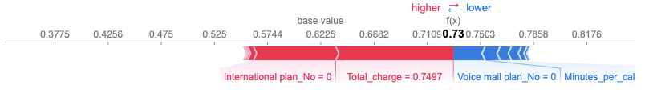
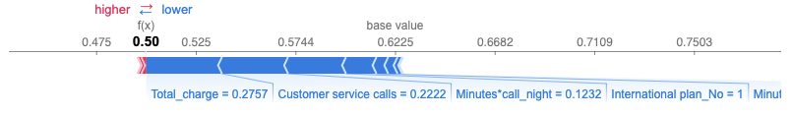
SHAP – Individual Predictions
Predicted churn who actually DIDN'T churn
Model predicted customer to churn because he/she had high bill and an international plan
Predicted NOT churn who actually DID churn
Model predicted customer will not churn because he/she had low bill and low customer service calls
Notes:
Now we will plot individual predictions to analyze each customer individually. A good use case would be to look at wrong predictions and try to understand why the model.
For the second plot it is important to note that there is no feature which increased likelihood to churn (red bars), this could mean that our features are still missing some information and we need to collect more data about customers to identify why this particular customer churned. From the dataset we have it may not be possible to predict

Slide 24
Questions?

